Slide 1
Register Transfer and Micro-operations <number>
Overview
Register Transfer Language
Register Transfer
Bus and Memory Transfers
Logic Micro-operations
Shift Micro-operations
Arithmetic Logic Shift Unit
CSE 211

Slide 2
Register Transfer and Micro-operations <number>
Connecting Registers - Bus Transfer
In a digital system with many registers, it is impractical to have data and control lines to directly allow each register to be loaded with the contents of every possible other registers
To completely connect n registers → n(n-1) lines
O(n²) cost
  This is not a realistic approach to use in a large digital system
Instead, take a different approach
Have one centralized set of circuits for data transfer – the bus
BUS STRUCTURE CONSISTS OF SET OF COMMON LINES, ONE FOR EACH BIT OF A REGISTER THROUGH WHICH BINARY INFORMATION IS TRANSFERRED ONE AT A TIME
Have control circuits to select which register is the source, and which is the destination
CSE 211

Slide 3
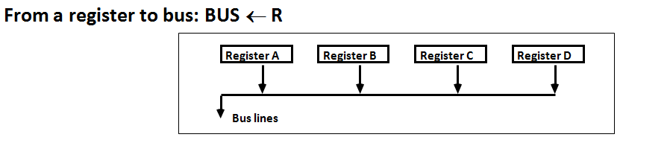
Register Transfer and Micro-operations <number>
Connecting Registers - Bus Transfer
One way of constructing common bus system is with multiplexers
Multiplexer selects the source register whose binary information is kept on the bus.
Construction of bus system for 4 register (Next Fig)
  4 bit register X 4
  four 4X1 multiplexer
  Bus selection S0, S1
CSE 211

Slide 4
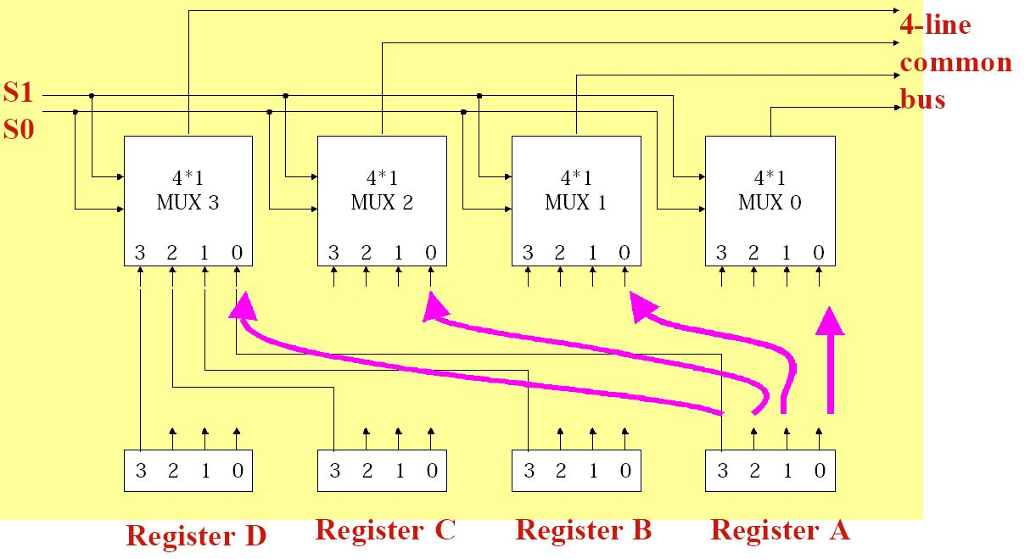
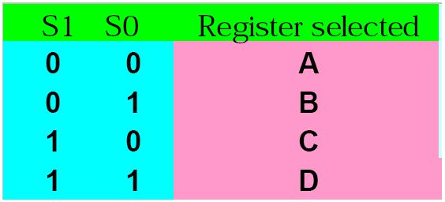
Register Transfer and Micro-operations <number>
Connecting Registers - Bus Transfer
CSE 211

Slide 5
Register Transfer and Micro-operations <number>
Connecting Registers - Bus Transfer
For a bus system to multiplex k registers of n bits each
  No. of multiplexer = n = No. of bits
  Size of each multiplexer = k x 1, k data lines in each MUX
Construction of bus system for 8 register with 16 bits
  16 bit register X 8
  Sixteen 8X1 multiplexer
  Bus selection S0, S1, S2
CSE 211

Slide 6
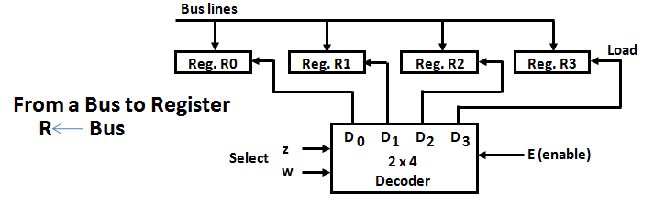
Register Transfer and Micro-operations <number>
Connecting Registers - Bus Transfer
CSE 211

Slide 7
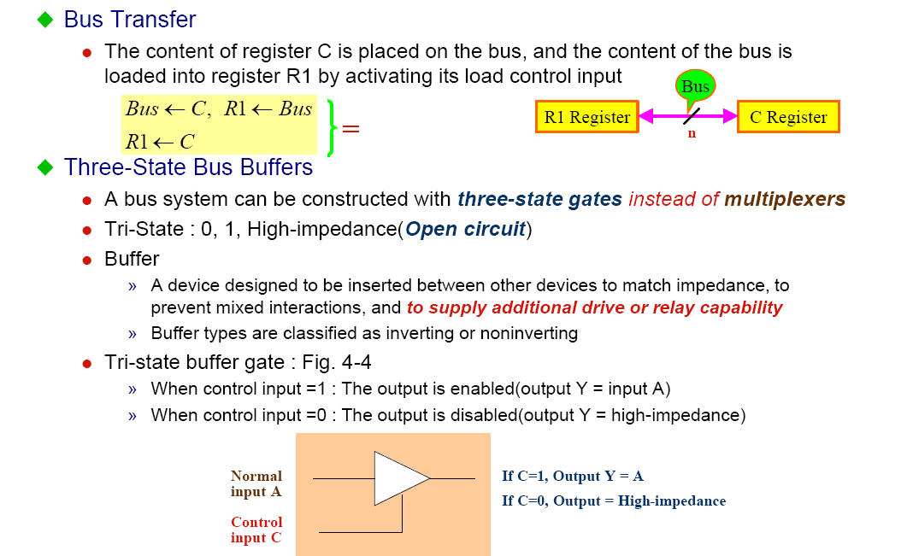
Register Transfer and Micro-operations <number>
Connecting Registers - Bus Transfer
CSE 211

Slide 8
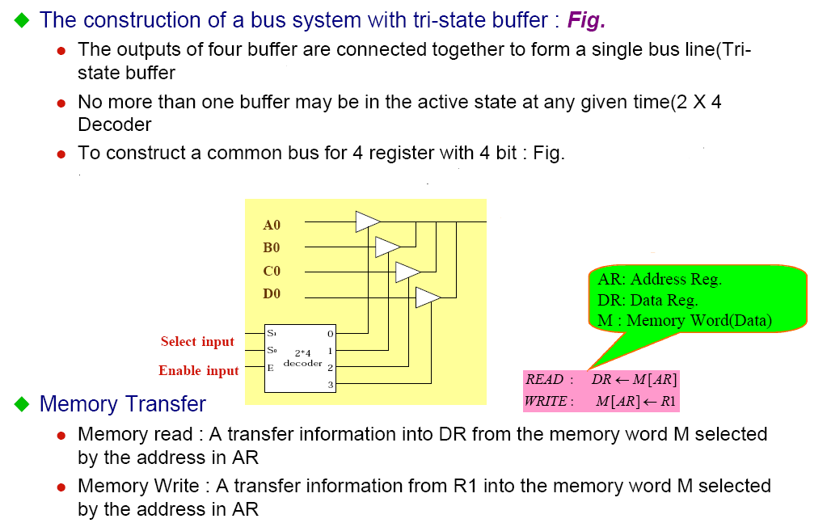
Register Transfer and Micro-operations <number>
Connecting Registers - Bus Transfer
CSE 211

Slide 9
Register Transfer and Micro-operations <number>
Memory - RAM
Memory (RAM) can be thought as a sequential circuits containing some number of registers
Memory stores binary information in groups of bits called words
These registers hold the words of memory
Each of the r registers is indicated by an address
These addresses range from 0 to r-1
Each register (word) can hold n bits of data
Assume the RAM contains r = 2^{k} words. It needs the following
  n data input lines
  n data output lines
  k address lines
  A Read control line
  A Write control line
data input lines
n
address lines
k
RAM
unit
Read
Write
n
data output lines

Slide 10
Register Transfer and Micro-operations <number>
Memory Transfer
Memory is usually accessed in computer systems by putting the desired address in a special register, the Memory Address Register (MAR, or AR)
M
Memory
unit
Read
AR
Write
Data out
Data in
CSE 211

Slide 11
Register Transfer and Micro-operations <number>
Memory Read
To read a value from a location in memory and load it into a register, the register transfer language notation looks like this:
This causes the following to occur
  The contents of the MAR get sent to the memory address lines
  A Read (= 1) gets sent to the memory unit
  The contents of the specified address are put on the memory’s output data lines
  These get sent over the bus to be loaded into register R1
R1 ← M[MAR]
CSE 211

Slide 12
Register Transfer and Micro-operations <number>
Memory Write
To write a value from a register to a location in memory looks like this in register transfer language:
This causes the following to occur
  The contents of the MAR get sent to the memory address lines
  A Write (= 1) gets sent to the memory unit
  The values in register R1 get sent over the bus to the data input lines of the memory
  The values get loaded into the specified address in the memory
M[MAR] ← R1
CSE 211

Slide 13
Register Transfer and Micro-operations <number>
MICROOPERATIONS
Computer system microoperations are of four types:
Register transfer microoperations
Arithmetic microoperations
Logic microoperations
Shift microoperations
CSE 211

Slide 14
Register Transfer and Micro-operations <number>
SUMMARY OF R. TRANSFER MICROOPERATIONS
A ← B 1.Transfer content of reg. B into reg. A
A ← constant 3.Transfer a binary constant into reg. A
ABUS ← R1, R2 ← ABUS 4.Transfer content of R1 into bus A and, at the same time,
transfer content of bus A into R2
AR 5.Address register
DR 6.Data register
M[R] 7.Memory word specified by reg. R
M 8.Equivalent to M[AR]
DR ← M 9.Memory read operation: transfers content of
memory word specified by AR into DR
M ← DR 10.Memory write operation: transfers content of
DR into memory word specified by AR
CSE 211

Slide 15
Register Transfer and Micro-operations <number>
Arithmetic MICROOPERATIONS
The basic arithmetic microoperations are
  Addition
  Subtraction
  Increment
  Decrement
The additional arithmetic microoperations are
  Add with carry
  Subtract with borrow
  Transfer/Load
  etc. …
Summary of Typical Arithmetic Micro-Operations
  R3 ← R1 + R2 Contents of R1 plus R2 transferred to R3
  R3 ← R1 - R2 Contents of R1 minus R2 transferred to R3
  R2 ← R2’ Complement the contents of R2
  R2 ← R2’+ 1 2's complement the contents of R2 (negate)
  R3 ← R1 + R2’+ 1 subtraction
  R1 ← R1 + 1 Increment
  R1 ← R1 - 1 Decrement
CSE 211

